Slide 1



Mayor’s
Office of Contract Compliance
Doing Business
with the
City of Atlanta
&
Beyond

Slide 2

Mayor’s
Office of Contract Compliance
Topics of Discussion
WHO IS OCC?
UNDERPINNING ORDINANCES
OCC STAFFING/FUNCTIONS
DETERMINING PROGRAM APPLICABILITY

Slide 3
Mayor’s
Office of Contract Compliance
Topics of Discussion
REGISTERING FOR PARTICIPATION
BEST PRACTICES FOR CERTIFICATION
PARTNER AGENCIES
PRIVATE SECTOR PROCUREMENTS

Slide 5
Mayor’s
Office of Contract Compliance
OCC Currently Has 19 Staff
Office of Contract Compliance
Organizational Chart
Director
Larry Scott
Administrative Assistant
Finus Hudson
Office Assistant
Alisasha Wellington
Senior Manager
(Watershed/General Fund)
Bruce Bell
Senior Manager
(Aviation)
Alberto Aponte
Senior Manager
(Renew Atlanta/TSPLOST, P3 )
Richard Case
Senior Manager
(Aviation Concessions)
Yvette Hawkins
Senior Manager
(Certification)
Meghan Payne
Contract Compliance Specialist
Denice Higgins
Contract Compliance Specialist
Max Lipscomb
Contract Compliance Specialist
Kevin Gilliam
Contract Compliance Specialist
Angela Fears
Contract Compliance Specialist
Tracey Sanders
Contract Compliance Specialist
Samuel Lipkins
Contract Compliance Specialist
Vacant
Renew Specialist
Marcus Choi
Contract Compliance Specialist
Andreyah Alexander
Contract Compliance Specialist
Angela Hunter
Contract Compliance Specialist
Keith Boykin

Slide 6
Mayor’s
Office of Contract Compliance
It is the policy of the City of Atlanta (The “City”) to actively promote full and equal opportunity for everyone doing business with the City of Atlanta.
The City of Atlanta Mayor’s Office of Contract Compliance is responsible for administering the City’s various diversity programs:
Equal Business Opportunity Program (EBO)
Small Business Opportunity Program (SBO & SBO Sheltered Market)
Disadvantaged Business Enterprise Program (DBE/ACDBE)

Slide 7
Mayor’s
Office of Contract Compliance
EBO - Construction- 26.1% MBE 11.1% FBE
EBO - Professional Svcs 26.5% MBE 8.2% FBE
EBO – Other Svcs 21.6% MBE 7.4% FBE
SBO - (Special Provisions For Sheltered Market) Up to 35%
DBE - (FAA - Non Concessions) 29%
ACDBE –(FAA - Concessions Except Rental Car) 41%
ACDBE - (FAA - Concessions Rental Car) 4.74%
DBE - (FTA ) 31.5%
DBE - (FHWA) 15%
* Goals set on a project by project basis
COA Program Availability

Slide 9


Mayor’s
Office of Contract Compliance
Title VI
OCC is responsible for the following related to overseeing Title VI:
Program Administration
-Ensure compliance with policies and procedures.
Complaints
-Ensure effort is made to resolve any discrimination complaints.
Data Collection
-Gather any statistical data respective to race, color, sex, etc.
Environmental Impact Statements
-Review Environmental Impact Statements or Assessments.
Training Programs
-Conduct training on Title VI issues.

Slide 10
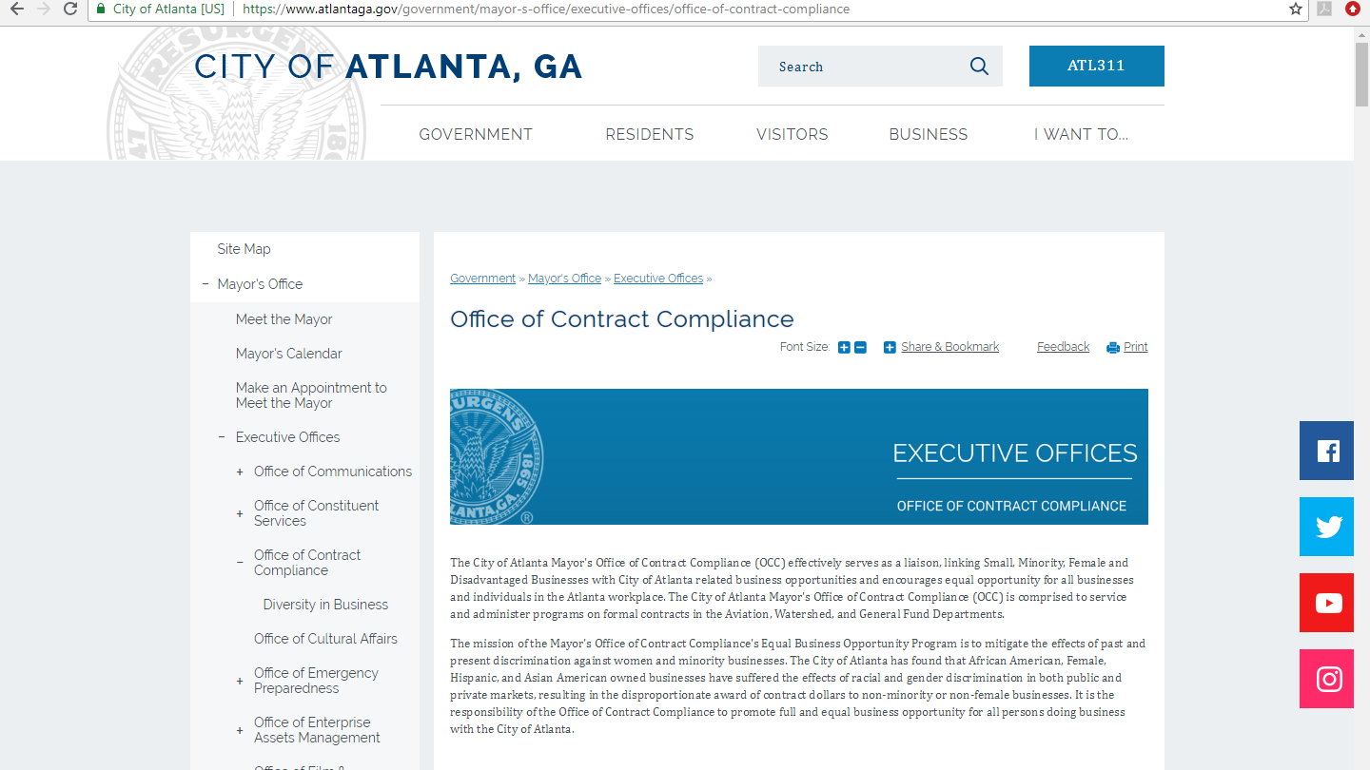
Mayor’s
Office of Contract Compliance
Certification Process

Slide 11
Mayor’s
Office of Contract Compliance
Certification
Process

Slide 12
Mayor’s
Office of Contract Compliance
Hooray!!
I’m Certified!! Now What?

Slide 14
Mayor’s
Office of Contract Compliance
City of Atlanta
Monitor OCC’s website often
-www.atlantaga.gov/contractcompliance
Periodically review DOP’s website
-procurement.atlantaga.gov

Slide 15
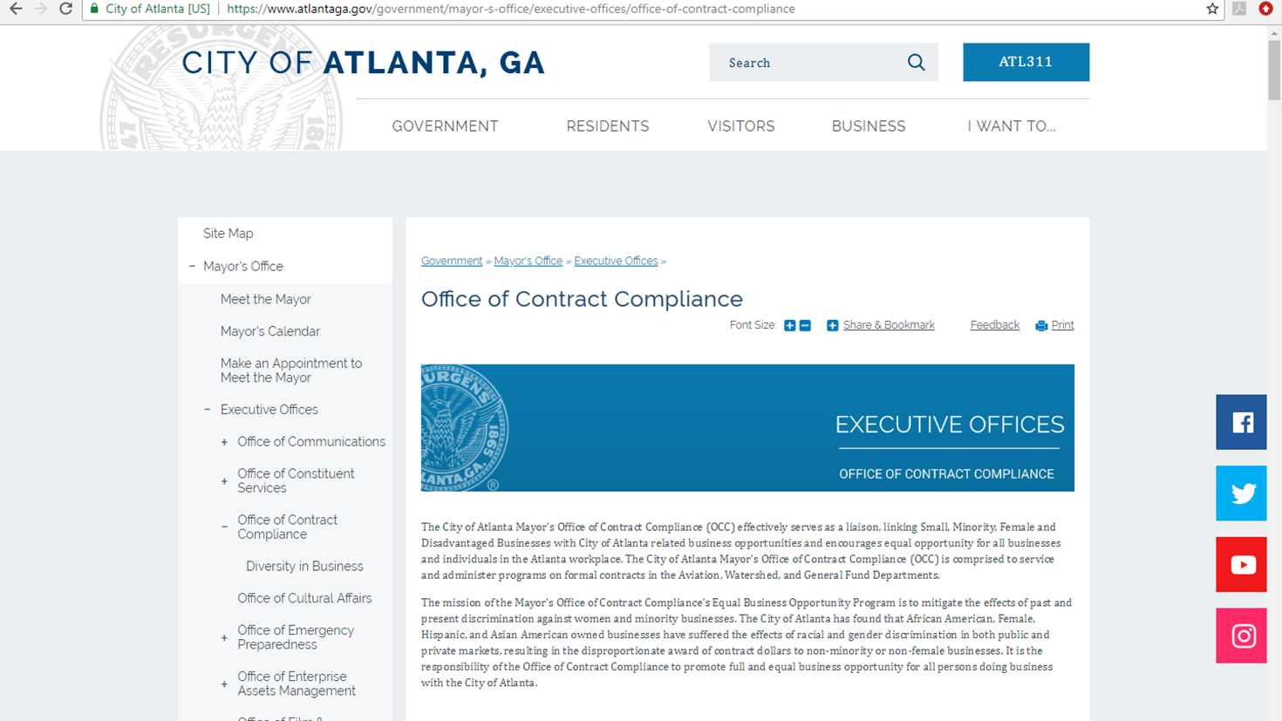
Mayor’s
Office of Contract Compliance

Slide 16
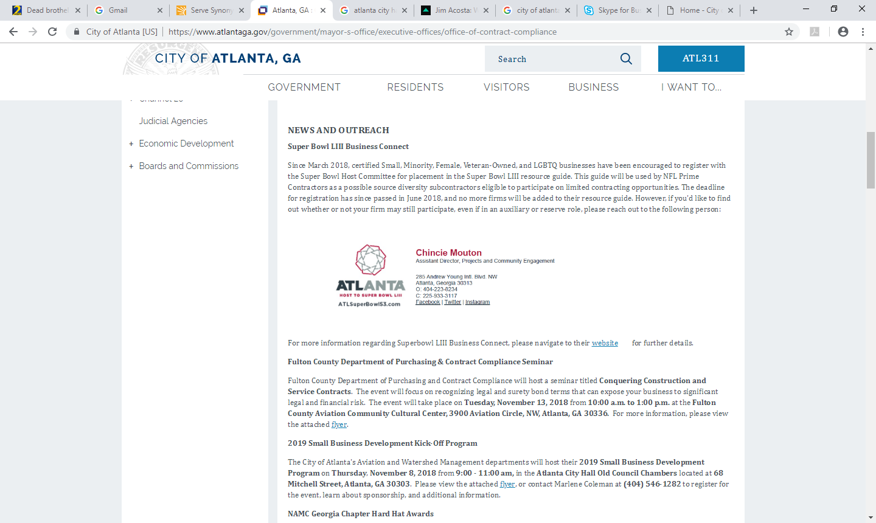
Mayor’s
Office of Contract Compliance

Slide 17
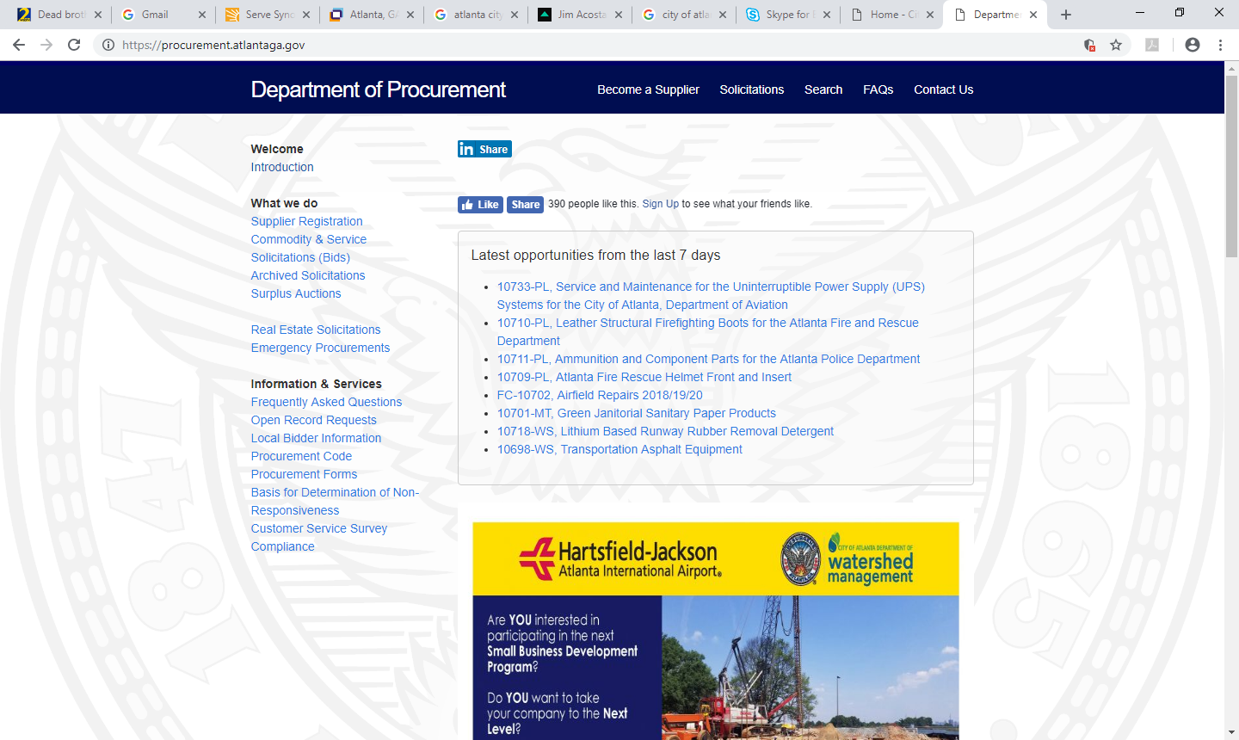
Mayor’s
Office of Contract Compliance

Slide 18
Mayor’s
Office of Contract Compliance
Partner Agencies
GDOT
MARTA
FULTON COUNTY
CLAYTON COUNTY CENTRAL SERVICES/CCWA
DEKALB COUNTY

Slide 19
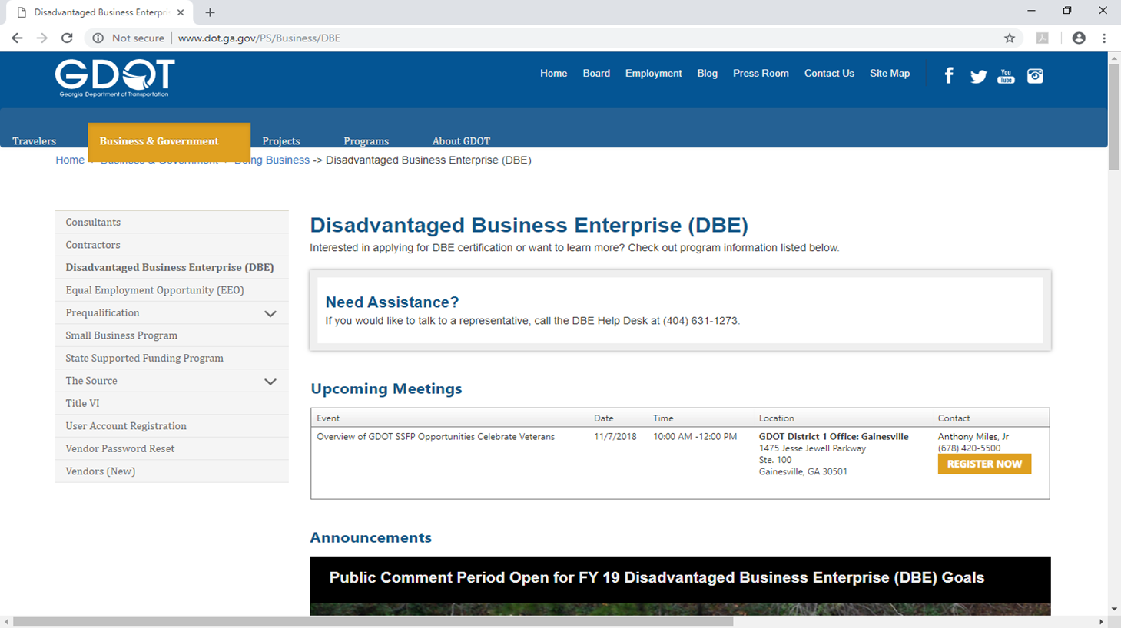
Mayor’s
Office of Contract Compliance

Slide 20
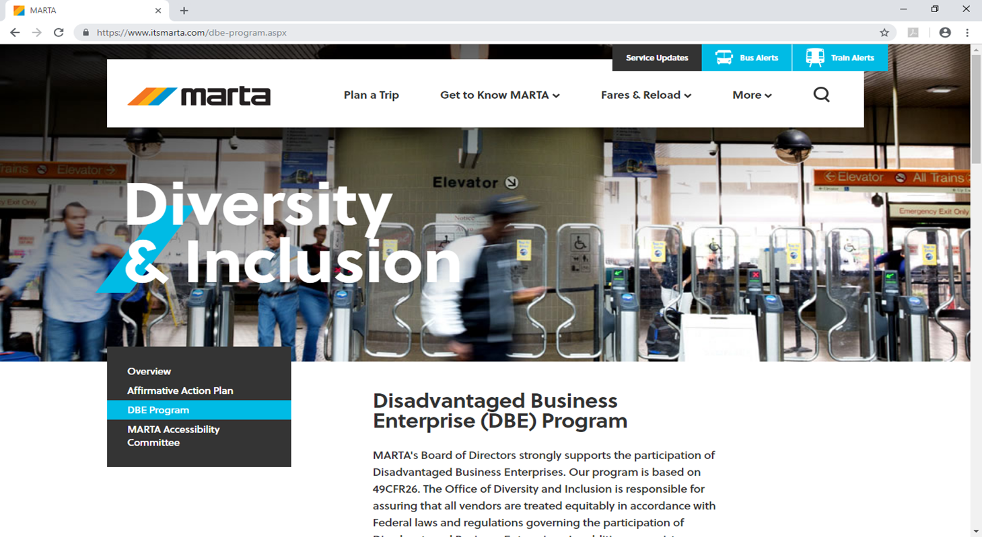
Mayor’s
Office of Contract Compliance

Slide 21
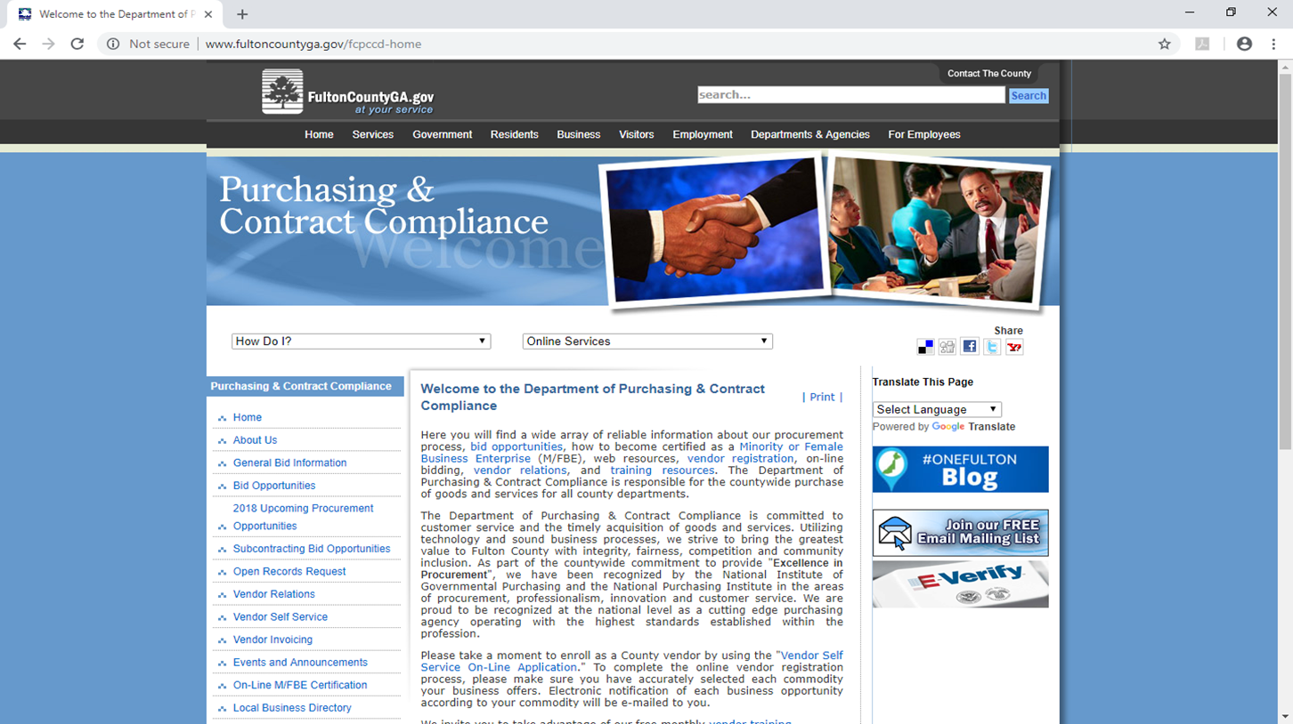
Mayor’s
Office of Contract Compliance

Slide 22
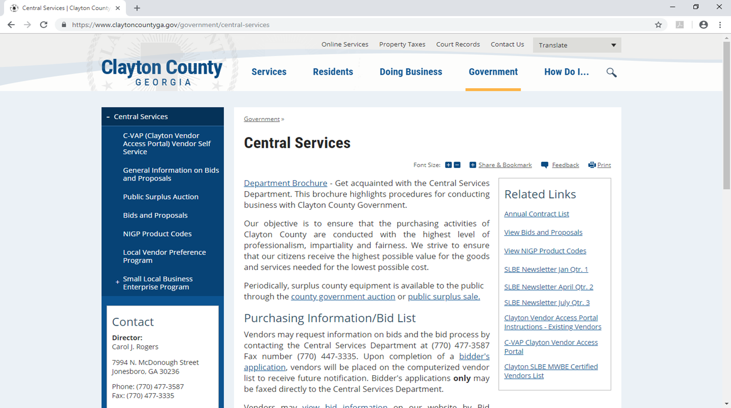
Mayor’s
Office of Contract Compliance

Slide 23
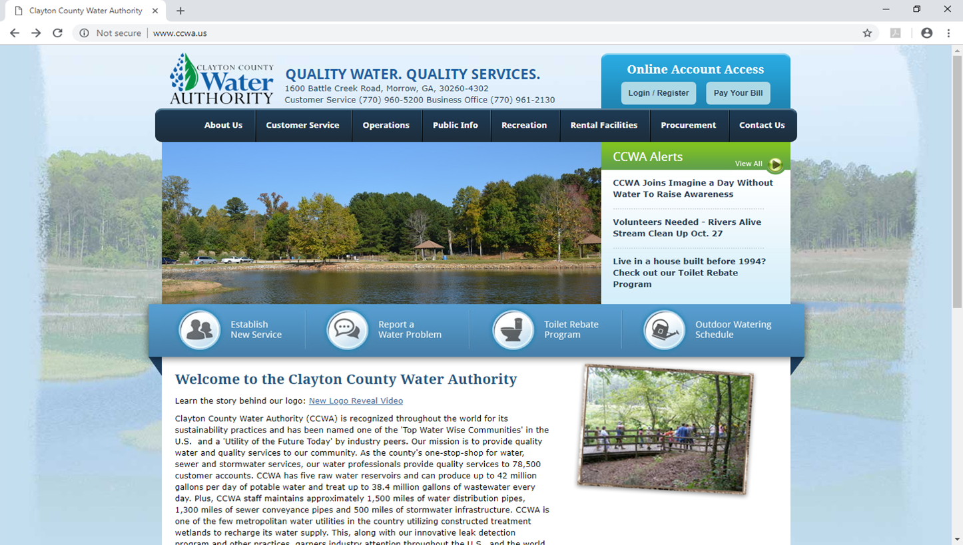
Mayor’s
Office of Contract Compliance

Slide 25
Mayor’s
Office of Contract Compliance
Private Sector
Delta Airlines
Coca Cola
Home Depot
Georgia Power

Slide 26
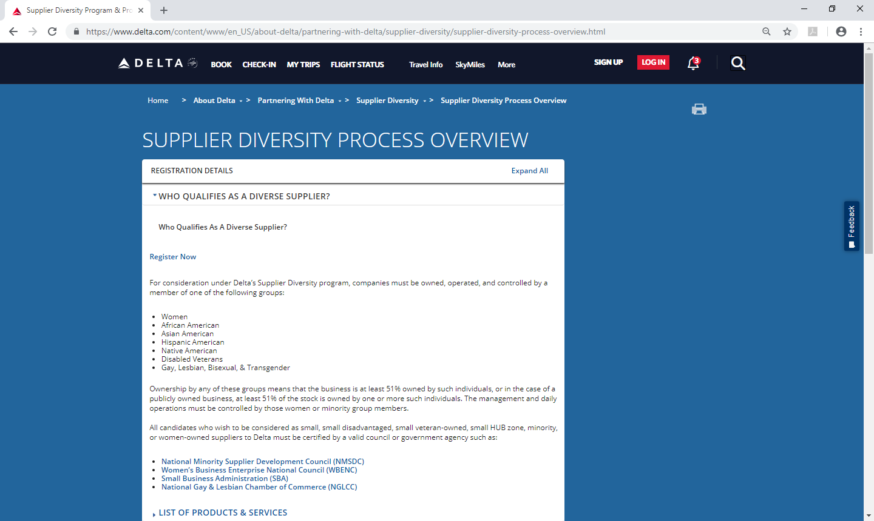
Mayor’s
Office of Contract Compliance

Slide 27

Mayor’s
Office of Contract Compliance

Slide 28
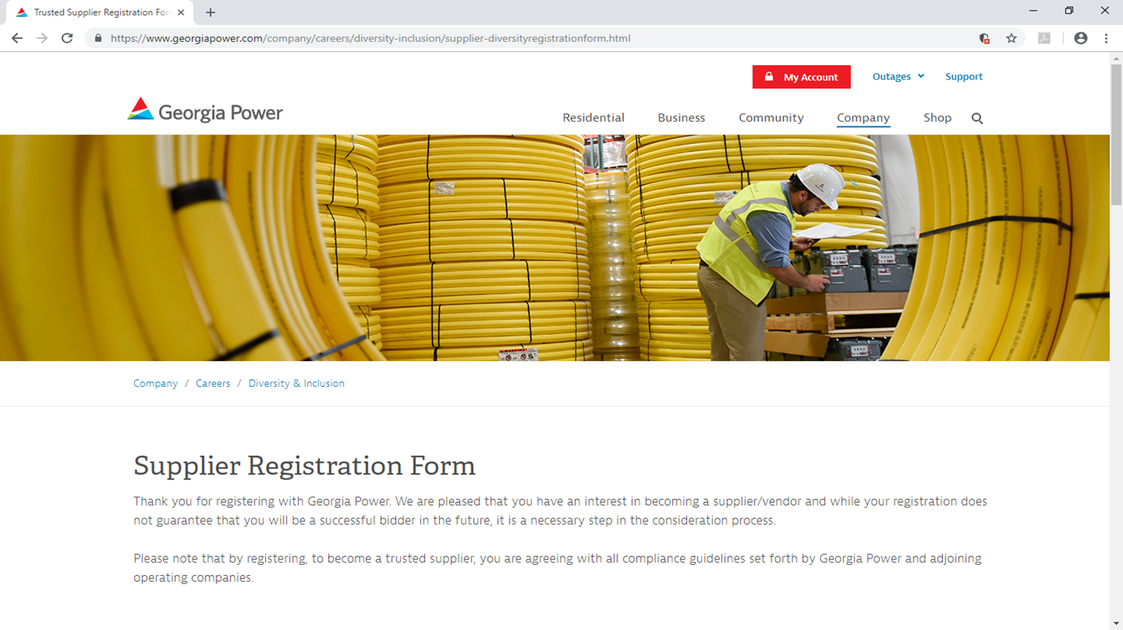
Mayor’s
Office of Contract Compliance

Slide 29

Mayor’s
Office of Contract Compliance
Revenue Pie
COA
Coca
Cola
MARTA
Other
Delta

Slide 31
Mayor’s
Office of Contract Compliance
Contact Information
  Mayor’s Office of Contract Compliance
  Richard D. Case, Sr. Manager
  68 Mitchell St SW Ste. 5100
  Atlanta, GA 30303
  404-330-6833
  www.atlantaga.gov/contractcompliance
  rcase@atlantaga.gov

Slide 33

Mayor’s
Office of Contract Compliance
Now, let’s tackle
tough questions!

